Slide 1
Information Retrieval System Evaluation
Contingency Matrix: A contingency matrix allows comparing the results automatically obtained by an IR system with the correct judgments manually provided by a human on the same dataset.

Slide 2
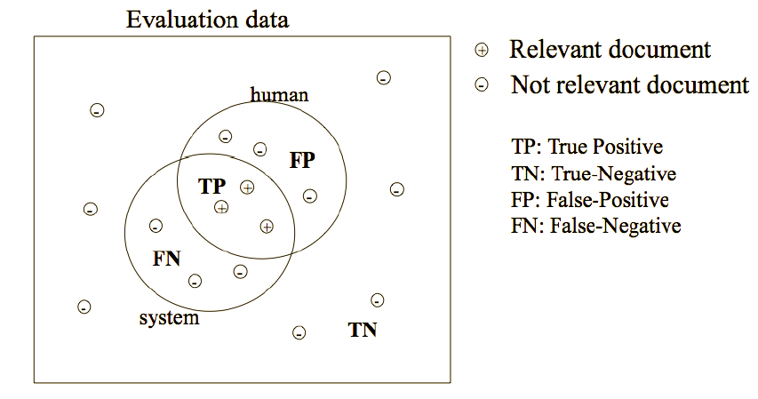
Information Retrieval System Evaluation

Slide 3
Information Retrieval System Evaluation
Accuracy Percentage of documents correctly classified by the system.
Accuracy= TP + TN/ TP+TN +FP+FN
Error Rate Inverse of accuracy. Percentage of documents wrongly classified by the system
FP+FN/ TP+TN +FP+FN
But: accuracy is not a good measure for IR.
In IR the number of TN (true negative) is usually much bigger than the number of true positive, false positive and false negative. Hence, we need a measure that does not consider TNs.

Slide 4
Information Retrieval System Evaluation
The effectiveness of an IR system (i.e., the quality of its search results) is determined by two key statistics about the system’s returned results for a query:
Precision: What fraction of the returned results are relevant to the information need?
Recall: What fraction of the relevant documents in the collection were returned by the system?
What is the best balance between the two?
Easy to get perfect recall: just retrieve everything.
Easy to get good precision: retrieve only the most relevant.

Slide 5
Precision:
percentage of relevant documents correctly retrieved by the system (TP)with respect to all documents retrieved by the system (TP + FP). (how many of the retrieved information are relevant?)
P =TP / TP+FP

Slide 6
Recall:
percentage of relevant documents correctly retrieved by the system (TP) with respect to all documents relevant for the human (TP + FN). (how many of the relevant information have been retrieved?)
R =TP / TP+FN

Slide 7
F-Measure: :
Combine in a single measure Precision (P) and Recall (R) giving aglobal estimation of the performance of an IR system.
F =2PR/ (R+P)

Slide 8
EXAMPLE 1:
 | Relevant | Not-relevant
Retrieved | TP=10 | FP=30
Not Retrieved | FN=5 | TN=55
Accuracy= TP + TN/ TP+TN +FP+FN
= (10+55) / (10+55+30+5)
=0.65
Error Rate =FP+FN/ TP+TN +FP+FN
=(30+5) / (10+55+30+5)
=0.35
Precision (P) = TP / (TP+FP)
= 10 / (10+30) = 0.25
Recall (R) = TP / (TP+FN)
= 10 / (10+5)
= 0.66
F-Measure= 2*P*R/ (P+R)
= ( 2 * 0.25 * 0.66) / ( 0.25 + 0.66)
= 0.38

